Slide 1
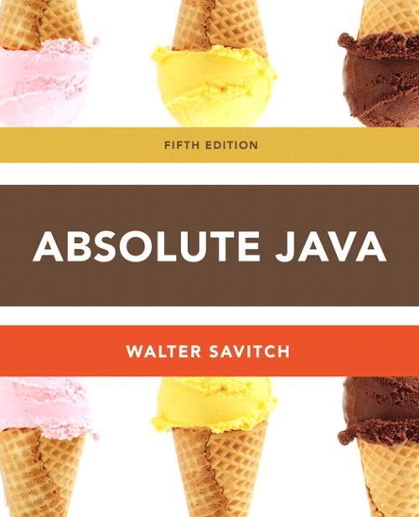
Chapter 5
Defining Classes II
Slides prepared by Rose Williams, Binghamton University
Kenrick Mock, University of Alaska Anchorage

Slide 2
Static Methods
A static method is one that can be used without a calling object
A static method still belongs to a class, and its definition is given inside the class definition
When a static method is defined, the keyword static is placed in the method header
public static returnedType myMethod(parameters)
{ . . . }
Static methods are invoked using the class name in place of a calling object
returnedValue = MyClass.myMethod(arguments);

Slide 3
Pitfall: Invoking a Nonstatic Method Within a Static Method
A static method cannot refer to an instance variable of the class, and it cannot invoke a nonstatic method of the class
A static method has no this, so it cannot use an instance variable or method that has an implicit or explicit this for a calling object
A static method can invoke another static method, however

Slide 4
Tip: You Can Put a main in any Class
Although the main method is often by itself in a class separate from the other classes of a program, it can also be contained within a regular class definition
In this way the class in which it is contained can be used to create objects in other classes, or it can be run as a program
A main method so included in a regular class definition is especially useful when it contains diagnostic code for the class

Slide 5
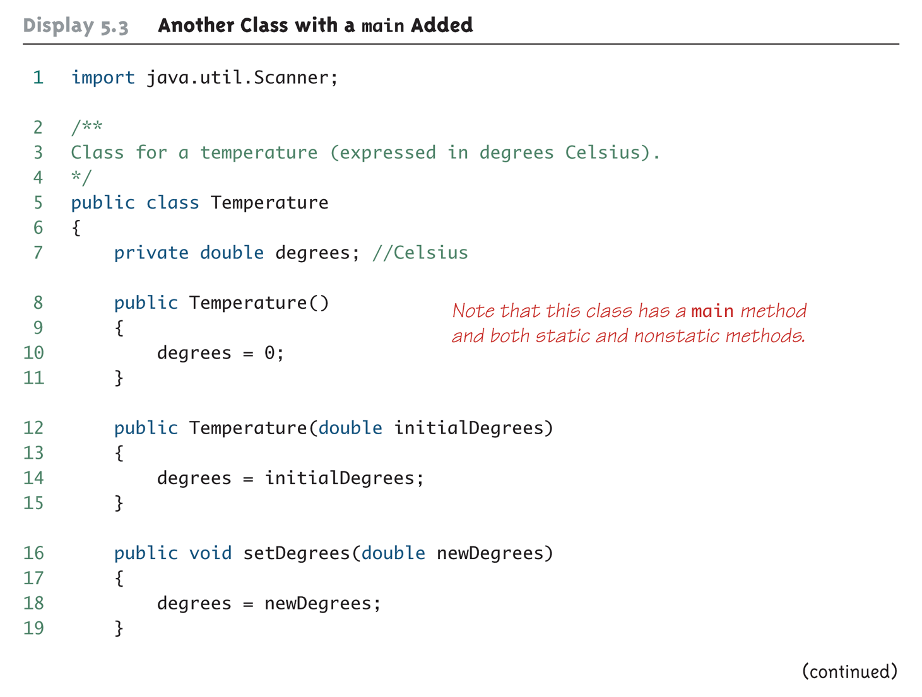
Another Class with a main Added (Part 1 of 4)

Slide 6
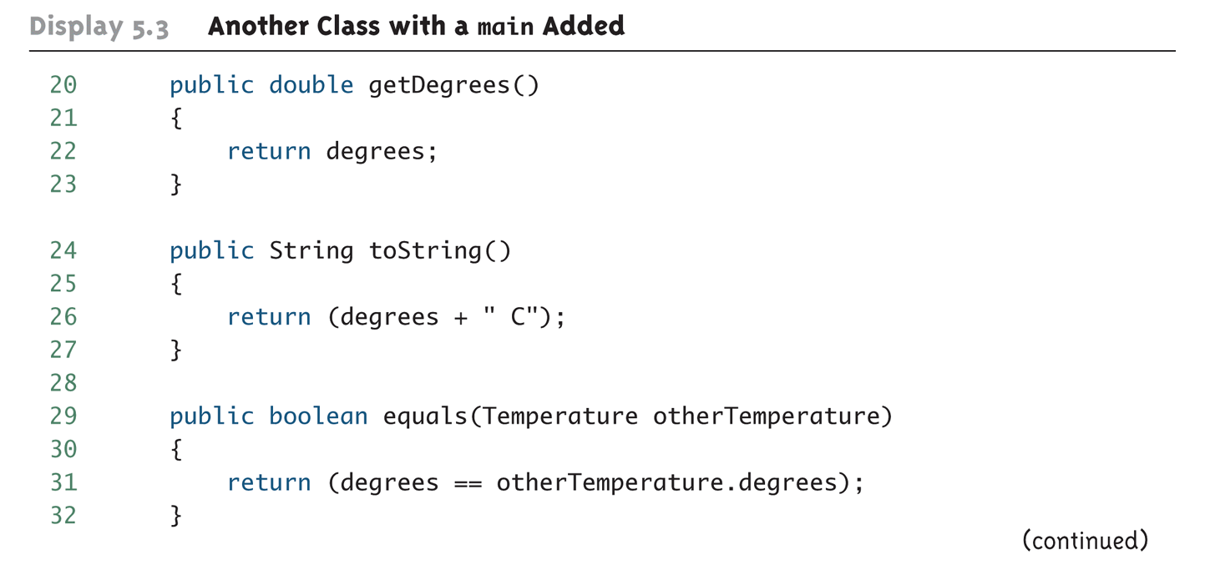
Another Class with a main Added (Part 2 of 4)

Slide 7
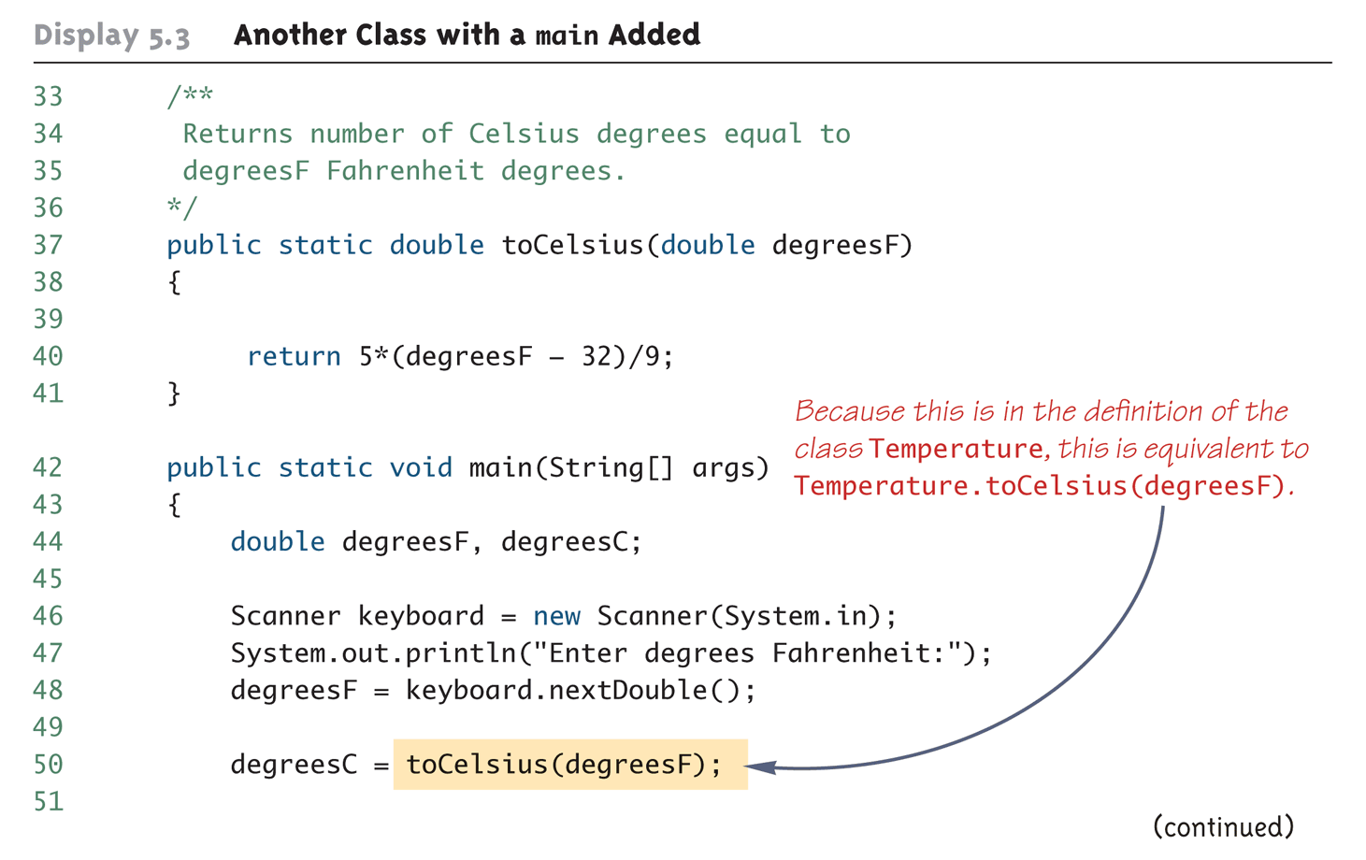
Another Class with a main Added (Part 3 of 4)

Slide 8
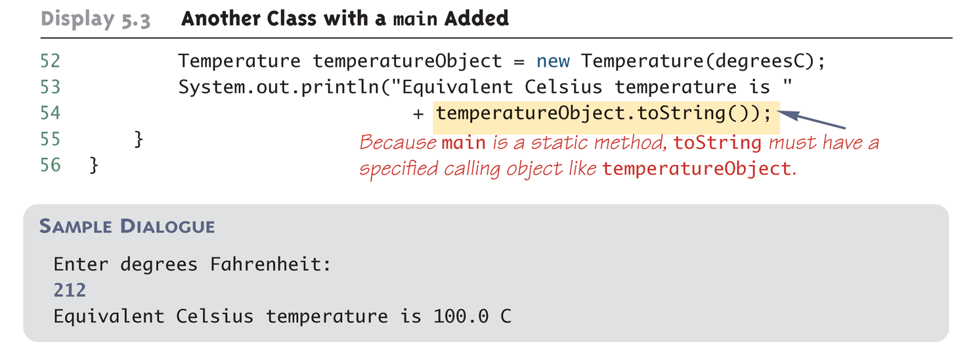
Another Class with a main Added (Part 4 of 4)

Slide 9
Static Variables
A static variable is a variable that belongs to the class as a whole, and not just to one object
There is only one copy of a static variable per class, unlike instance variables where each object has its own copy
All objects of the class can read and change a static variable
Although a static method cannot access an instance variable, a static method can access a static variable
A static variable is declared like an instance variable, with the addition of the modifier static
private static int myStaticVariable;

Slide 10
Static Variables
Static variables can be declared and initialized at the same time
private static int myStaticVariable = 0;
If not explicitly initialized, a static variable will be automatically initialized to a default value
boolean static variables are initialized to false
Other primitive types static variables are initialized to the zero of their type
Class type static variables are initialized to null
It is always preferable to explicitly initialize static variables rather than rely on the default initialization

Slide 11
Static Variables
A static variable should always be defined private, unless it is also a defined constant
The value of a static defined constant cannot be altered, therefore it is safe to make it public
In addition to static, the declaration for a static defined constant must include the modifier final, which indicates that its value cannot be changed
public static final int BIRTH_YEAR = 1954;
When referring to such a defined constant outside its class, use the name of its class in place of a calling object
int year = MyClass.BIRTH_YEAR;

Slide 12
The Math Class
The Math class provides a number of standard mathematical methods
It is found in the java.lang package, so it does not require an import statement
All of its methods and data are static, therefore they are invoked with the class name Math instead of a calling object
The Math class has two predefined constants, E (e, the base of the natural logarithm system) and PI (π, 3.1415 . . .)
area = Math.PI * radius * radius;

Slide 13
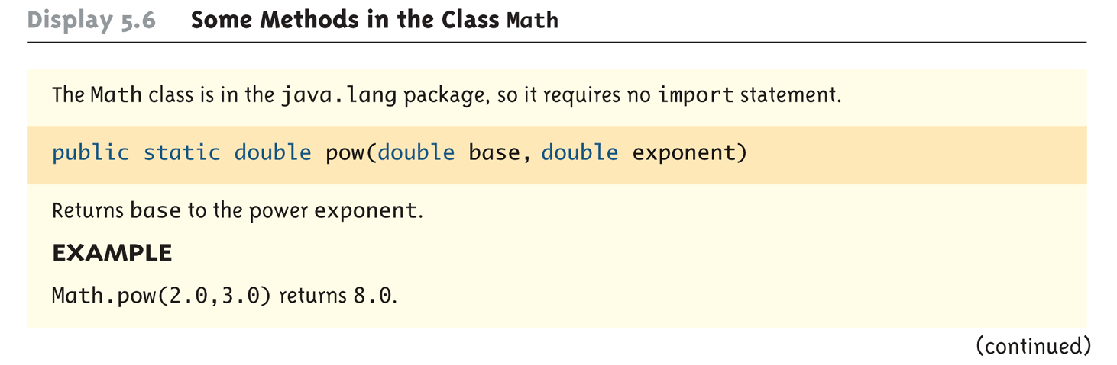
Some Methods in the Class Math (Part 1 of 5)

Slide 14
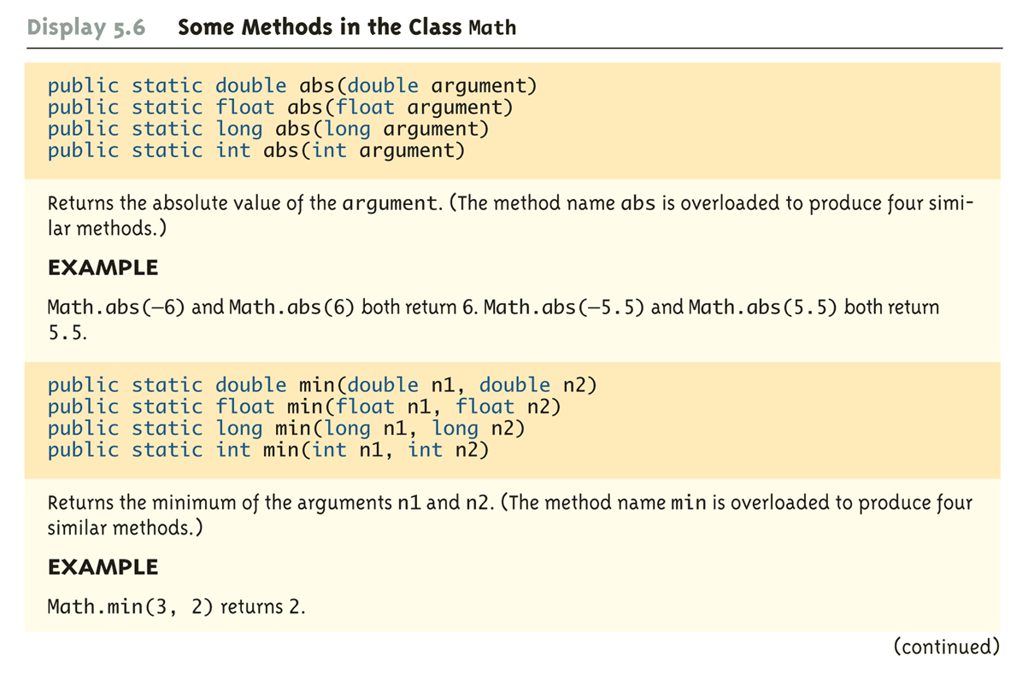
Some Methods in the Class Math (Part 2 of 5)

Slide 15
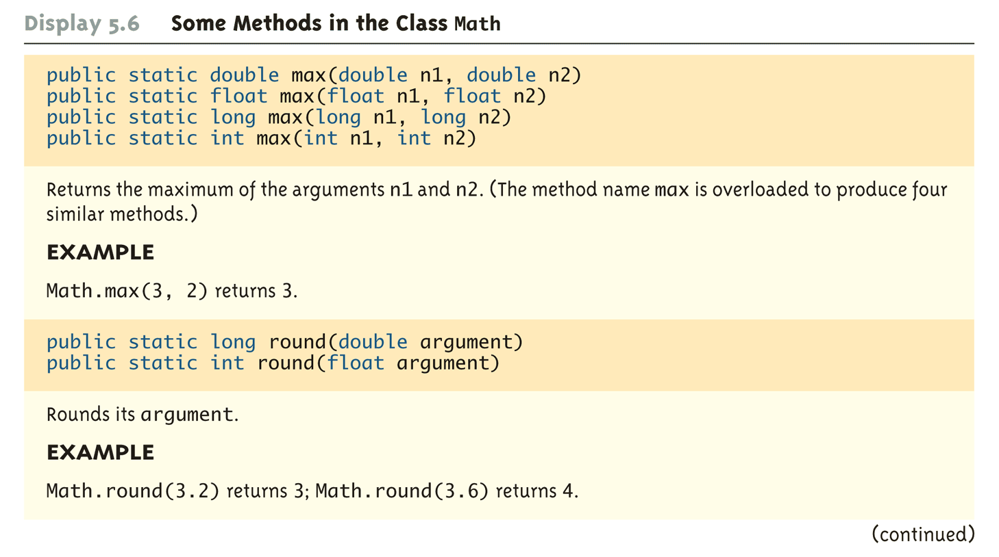
Some Methods in the Class Math (Part 3 of 5)

Slide 16
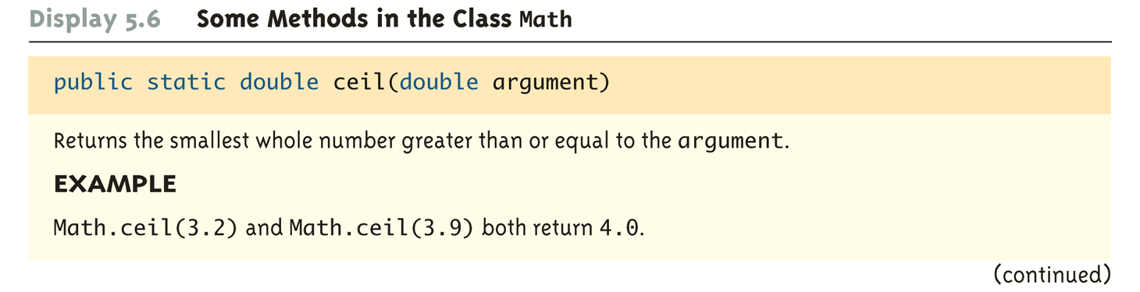
Some Methods in the Class Math (Part 4 of 5)

Slide 17
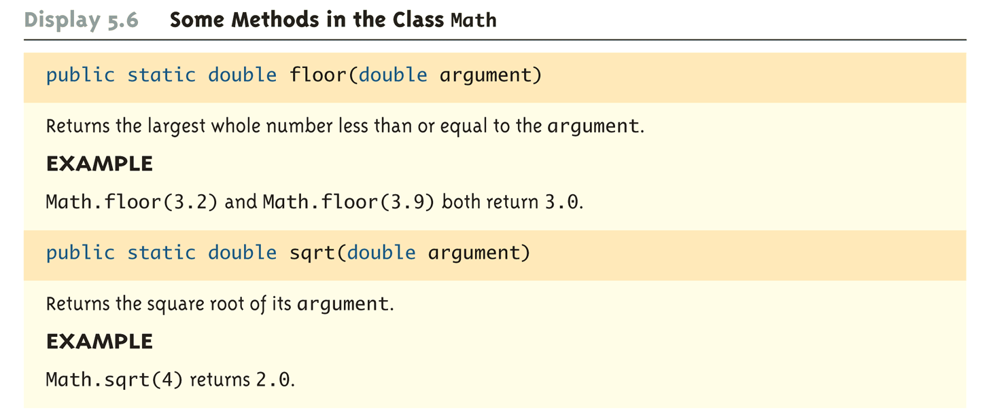
Some Methods in the Class Math (Part 5 of 5)

Slide 18
Random Numbers
The Math class also provides a facility to generate pseudo-random numbers
A pseudo-random number appears random but is really generated by a deterministic function
There is also a more flexible class named Random
Sample use:
Returns a pseudo-random number greater than or equal to 0.0 and less than 1.0
public static double random()
double num = Math.random();

Slide 19
Wrapper Classes
Wrapper classes provide a class type corresponding to each of the primitive types
This makes it possible to have class types that behave somewhat like primitive types
The wrapper classes for the primitive types byte, short, long, float, double, and char are (in order) Byte, Short, Long, Float, Double, and Character
Wrapper classes also contain a number of useful predefined constants and static methods

Slide 20
Wrapper Classes
Boxing: the process of going from a value of a primitive type to an object of its wrapper class
To convert a primitive value to an "equivalent" class type value, create an object of the corresponding wrapper class using the primitive value as an argument
The new object will contain an instance variable that stores a copy of the primitive value
Unlike most other classes, a wrapper class does not have a no-argument constructor
Integer integerObject = new Integer(42);

Slide 21
Wrapper Classes
Unboxing: the process of going from an object of a wrapper class to the corresponding value of a primitive type
The methods for converting an object from the wrapper classes Byte, Short, Integer, Long, Float, Double, and Character to their corresponding primitive type are (in order) byteValue, shortValue, intValue, longValue, floatValue, doubleValue, and charValue
None of these methods take an argument
int i = integerObject.intValue();

Slide 22
Automatic Boxing and Unboxing
Starting with version 5.0, Java can automatically do boxing and unboxing
Instead of creating a wrapper class object using the new operation (as shown before), it can be done as an automatic type cast:
Integer integerObject = 42;
Instead of having to invoke the appropriate method (such as intValue, doubleValue, charValue, etc.) in order to convert from an object of a wrapper class to a value of its associated primitive type, the primitive value can be recovered automatically
int i = integerObject;

Slide 23
Constants and Static Methods in Wrapper Classes
Wrapper classes include useful constants that provide the largest and smallest values for any of the primitive number types
For example, Integer.MAX_VALUE, Integer.MIN_VALUE, Double.MAX_VALUE, Double.MIN_VALUE, etc.
The Boolean class has names for two constants of type Boolean
Boolean.TRUE and Boolean.FALSE are the Boolean objects that correspond to the values true and false of the primitive type boolean

Slide 24
Constants and Static Methods in Wrapper Classes
Wrapper classes have static methods that convert a correctly formed string representation of a number to the number of a given type
The methods Integer.parseInt, Long.parseLong, Float.parseFloat, and Double.parseDouble do this for the primitive types (in order) int, long, float, and double
Wrapper classes also have static methods that convert from a numeric value to a string representation of the value
For example, the expression
Double.toString(123.99);
returns the string value "123.99"
The Character class contains a number of static methods that are useful for string processing

Slide 25
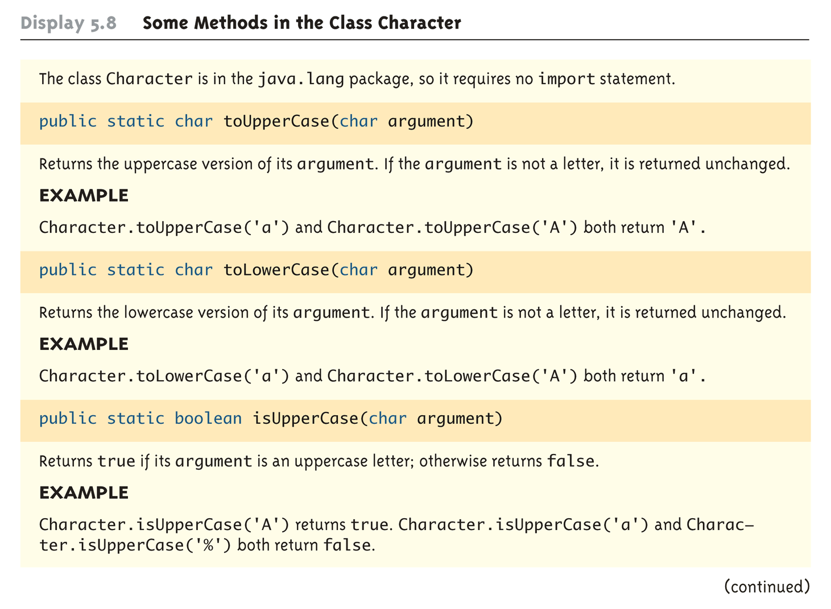
Some Methods in the Class Character (Part 1 of 3)

Slide 26
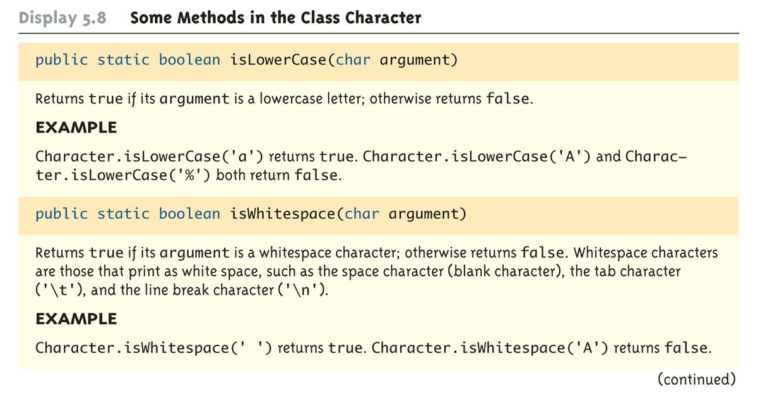
Some Methods in the Class Character (Part 2 of 3)

Slide 27
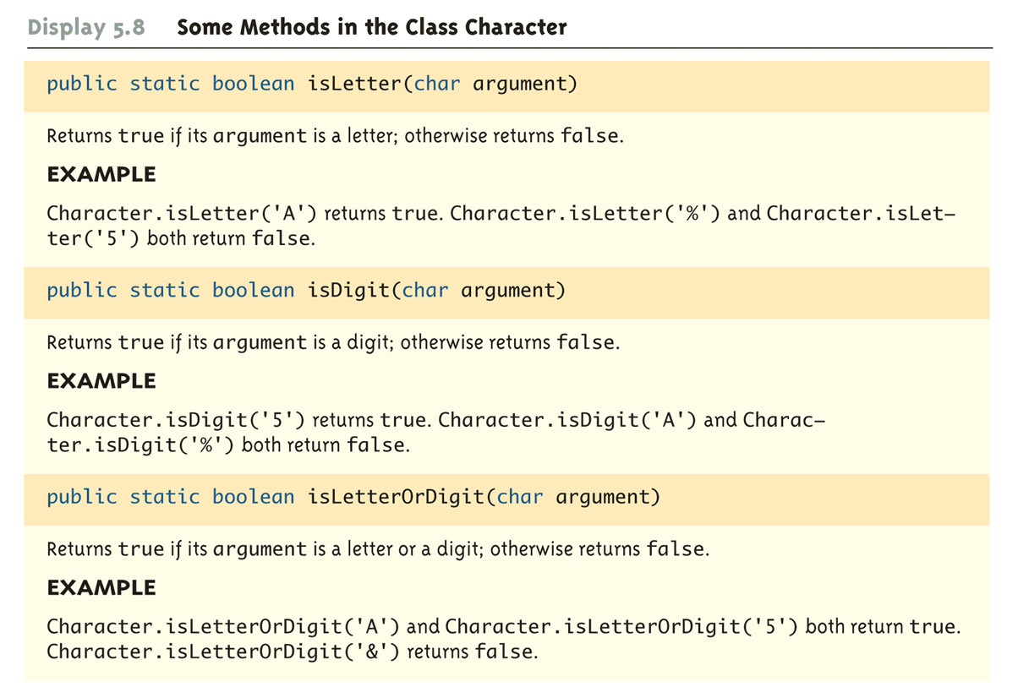
Some Methods in the Class Character (Part 3 of 3)

Slide 28
Variables and Memory
A computer has two forms of memory
Secondary memory is used to hold files for "permanent" storage
Main memory is used by a computer when it is running a program
Values stored in a program's variables are kept in main memory

Slide 29
Variables and Memory
Main memory consists of a long list of numbered locations called bytes
Each byte contains eight bits: eight 0 or 1 digits
The number that identifies a byte is called its address
A data item can be stored in one (or more) of these bytes
The address of the byte is used to find the data item when needed

Slide 30
Variables and Memory
Values of most data types require more than one byte of storage
Several adjacent bytes are then used to hold the data item
The entire chunk of memory that holds the data is called its memory location
The address of the first byte of this memory location is used as the address for the data item
A computer's main memory can be thought of as a long list of memory locations of varying sizes

Slide 31
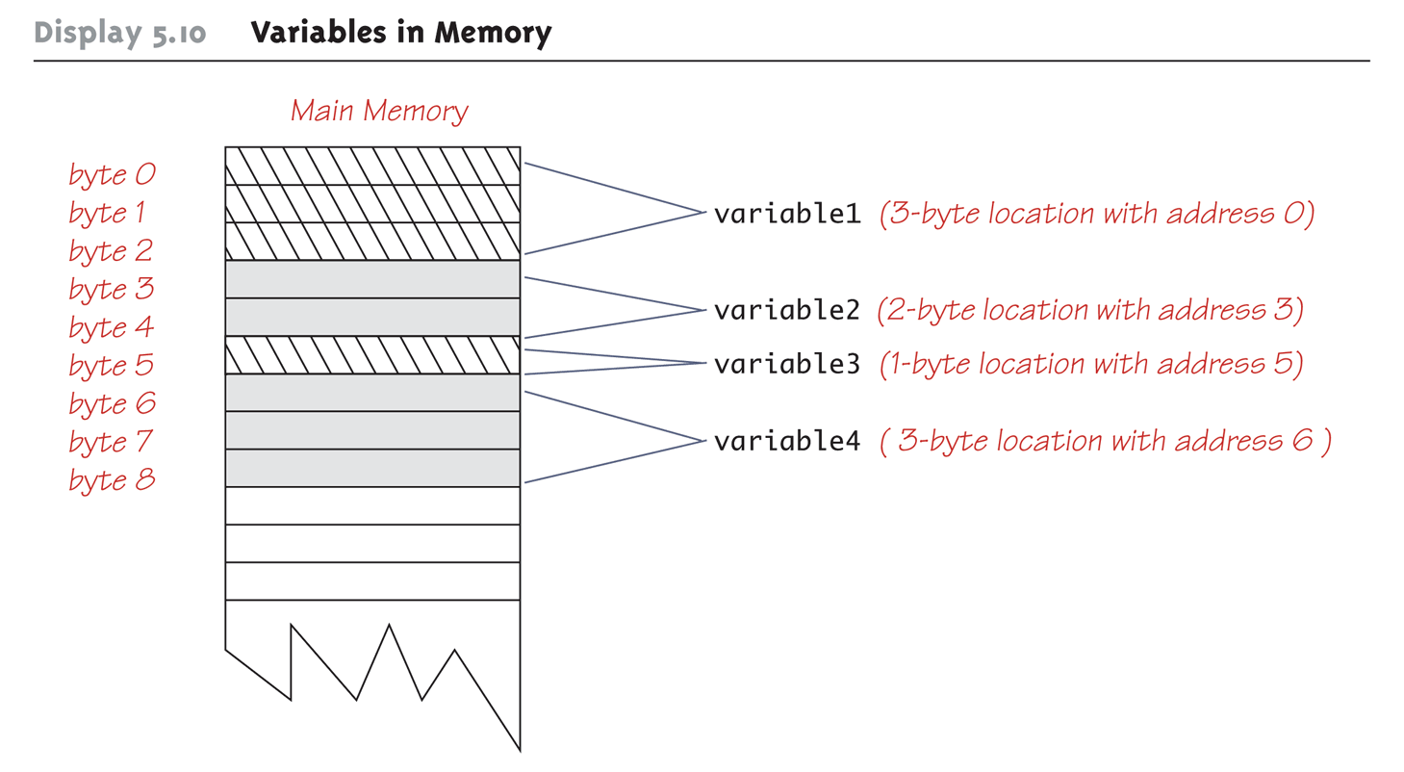
Variables in Memory

Slide 32
References
Every variable is implemented as a location in computer memory
When the variable is a primitive type, the value of the variable is stored in the memory location assigned to the variable
Each primitive type always require the same amount of memory to store its values

Slide 33
References
When the variable is a class type, only the memory address (or reference) where its object is located is stored in the memory location assigned to the variable
The object named by the variable is stored in some other location in memory
Like primitives, the value of a class variable is a fixed size
Unlike primitives, the value of a class variable is a memory address or reference
The object, whose address is stored in the variable, can be of any size

Slide 34
References
Two reference variables can contain the same reference, and therefore name the same object
The assignment operator sets the reference (memory address) of one class type variable equal to that of another
Any change to the object named by one of theses variables will produce a change to the object named by the other variable, since they are the same object
variable2 = variable1;

Slide 35
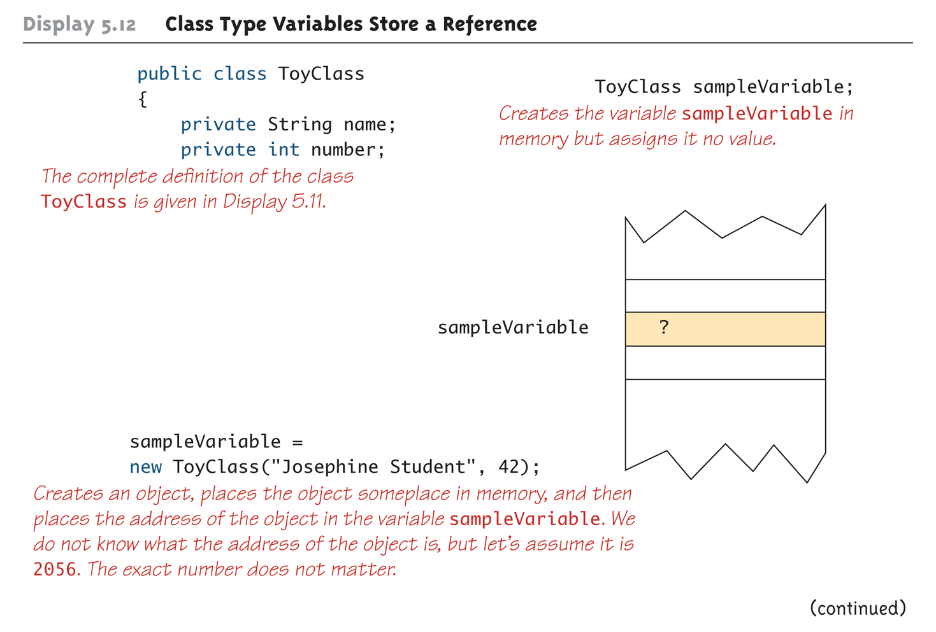
Class Type Variables Store a Reference (Part 1 of 2)

Slide 36
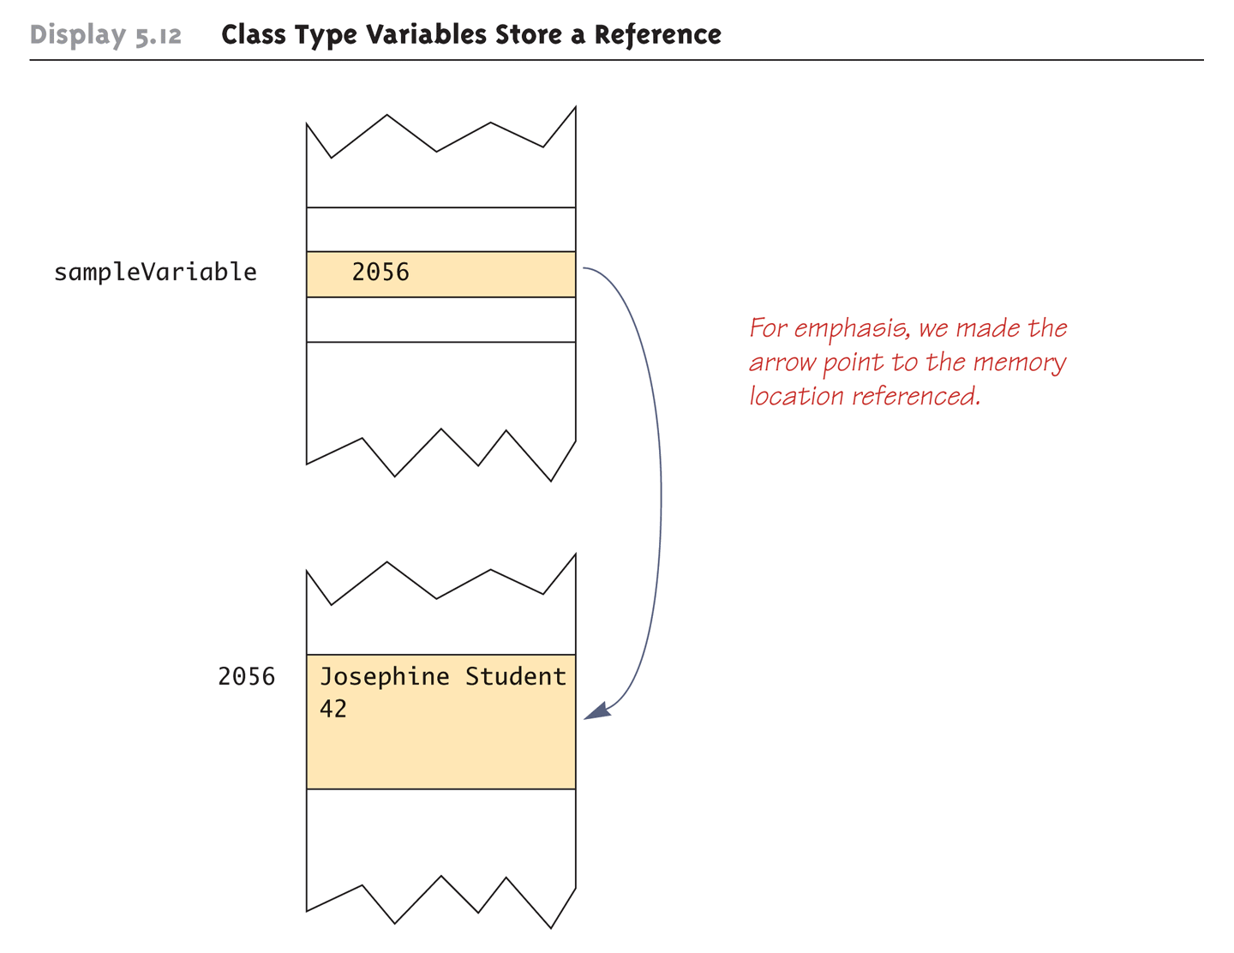
Class Type Variables Store a Reference (Part 2 of 2)

Slide 37
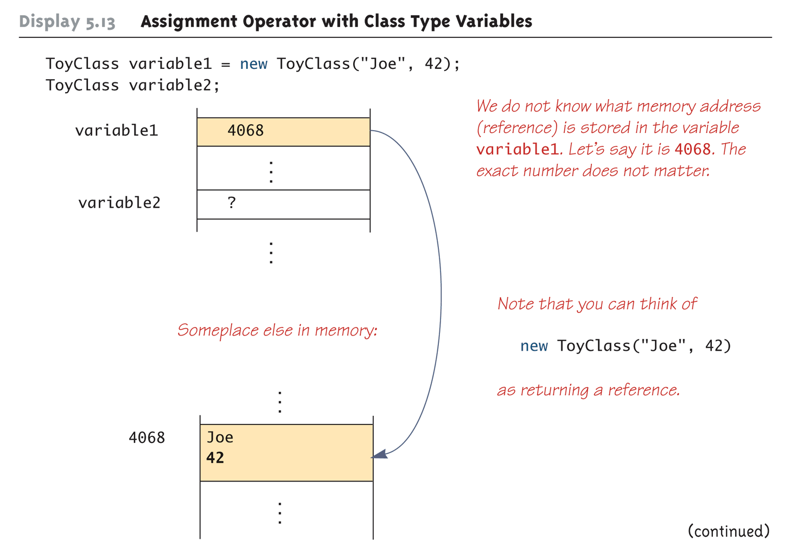
Assignment Operator with Class Type Variables (Part 1 of 3)

Slide 38
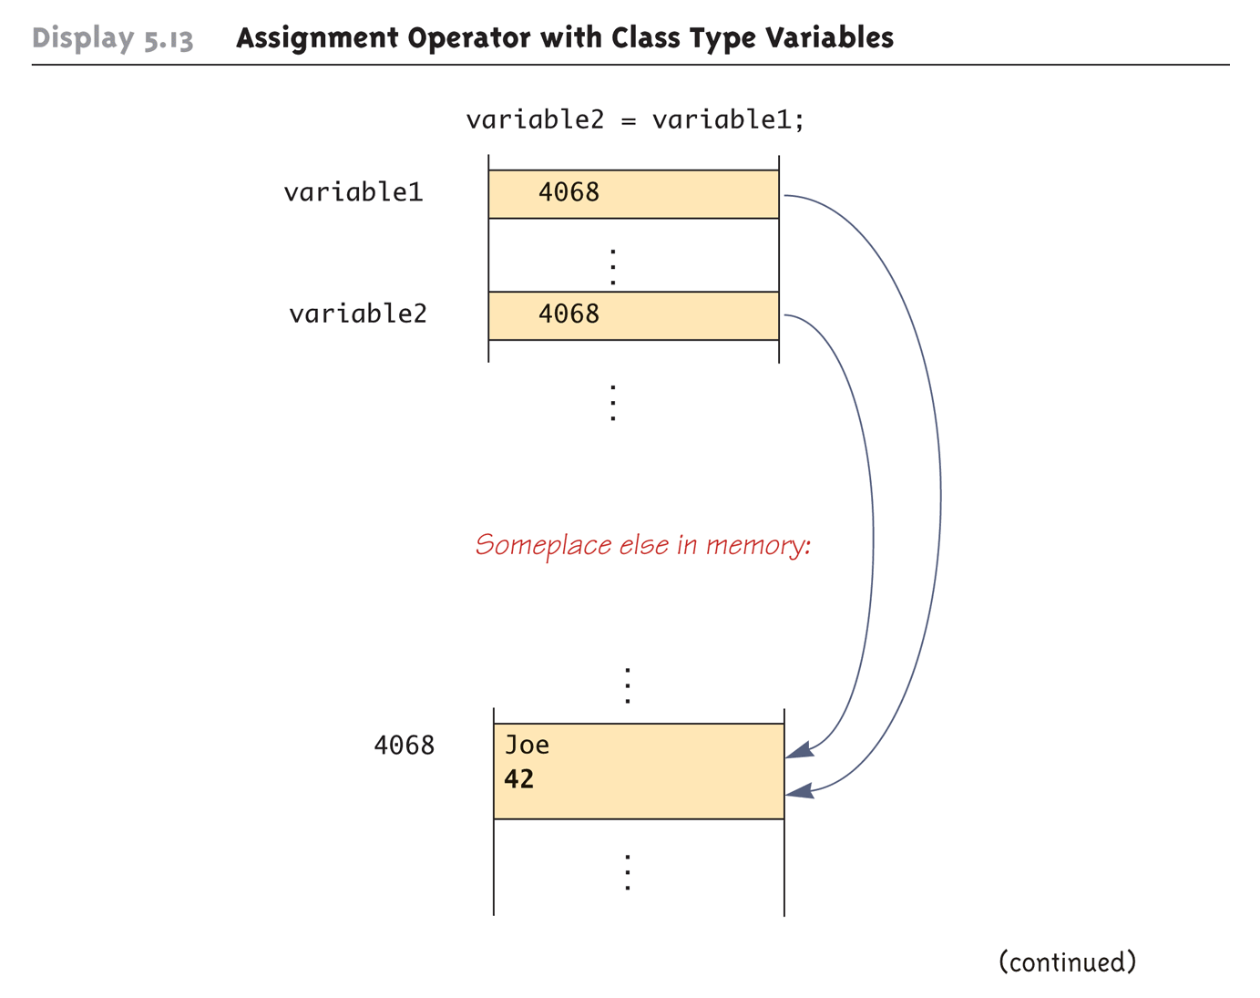
Assignment Operator with Class Type Variables (Part 2 of 3)

Slide 39
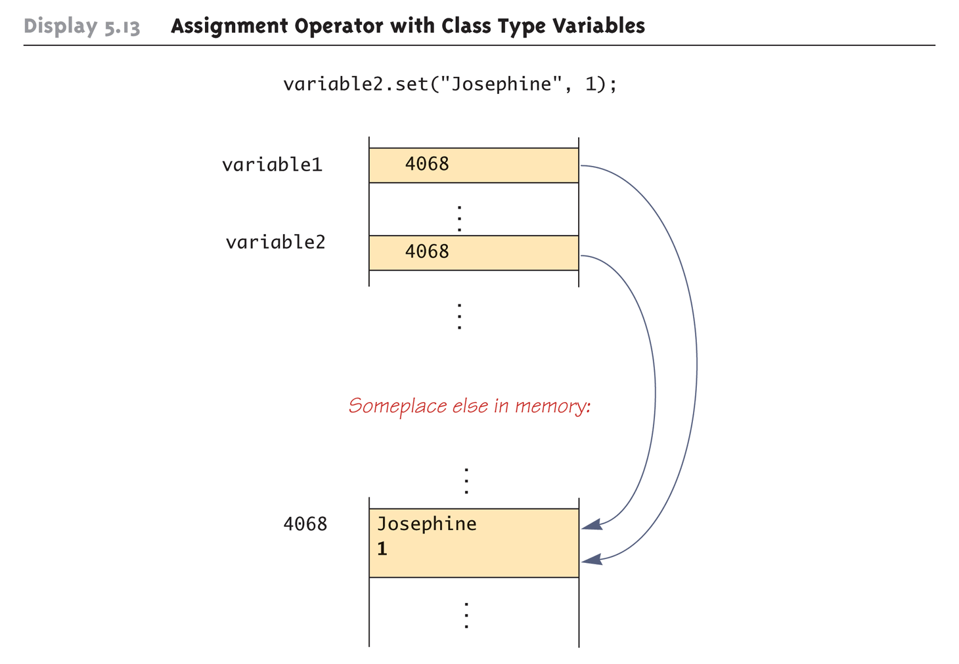
Assignment Operator with Class Type Variables (Part 3 of 3)

Slide 40
Class Parameters
All parameters in Java are call-by-value parameters
A parameter is a local variable that is set equal to the value of its argument
Therefore, any change to the value of the parameter cannot change the value of its argument
Class type parameters appear to behave differently from primitive type parameters
They appear to behave in a way similar to parameters in languages that have the call-by-reference parameter passing mechanism

Slide 41
Class Parameters
The value plugged into a class type parameter is a reference (memory address)
Therefore, the parameter becomes another name for the argument
Any change made to the object named by the parameter (i.e., changes made to the values of its instance variables) will be made to the object named by the argument, because they are the same object
Note that, because it still is a call-by-value parameter, any change made to the class type parameter itself (i.e., its address) will not change its argument (the reference or memory address)

Slide 42
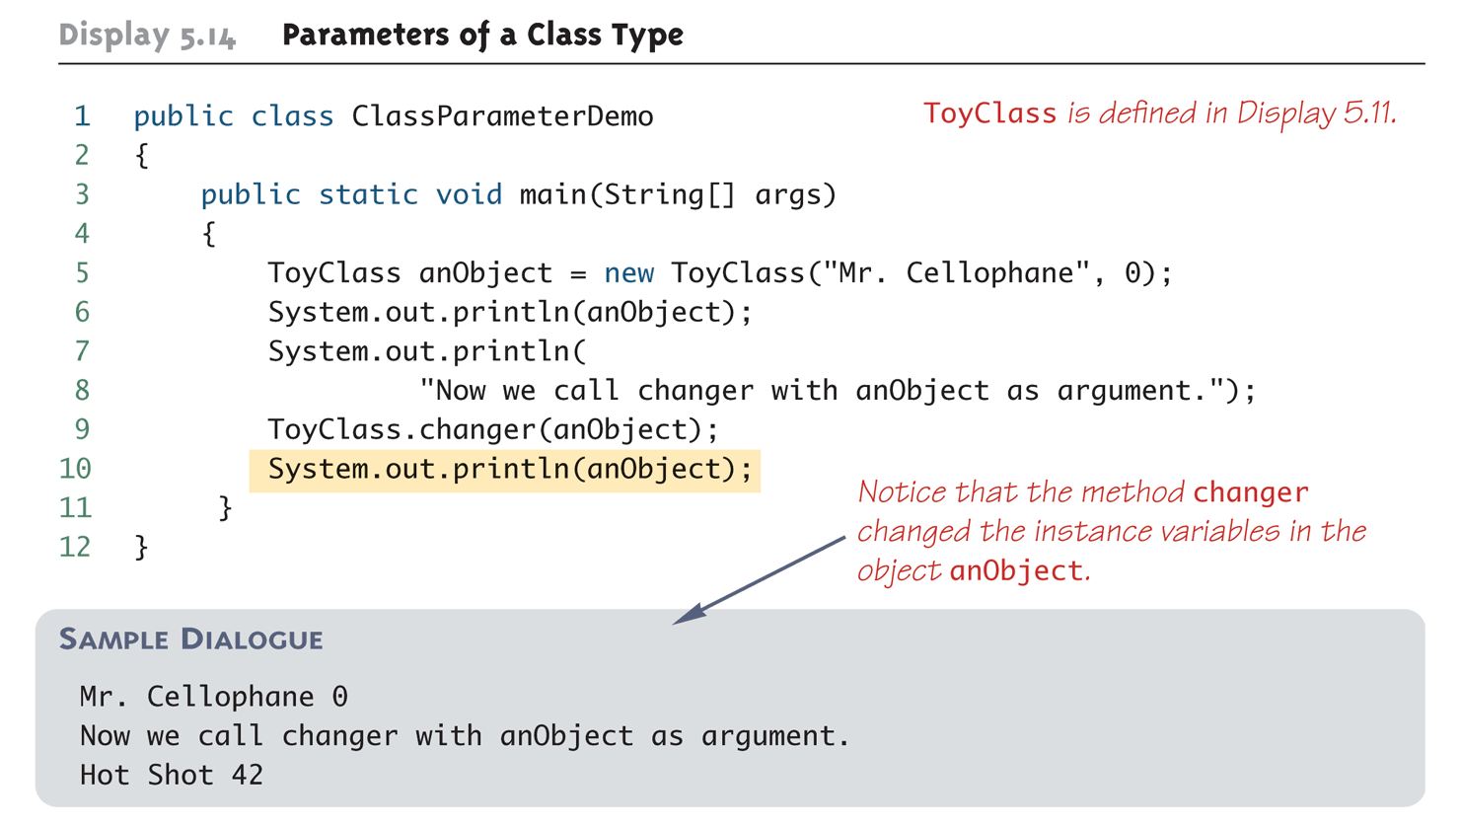
Parameters of a Class Type

Slide 43
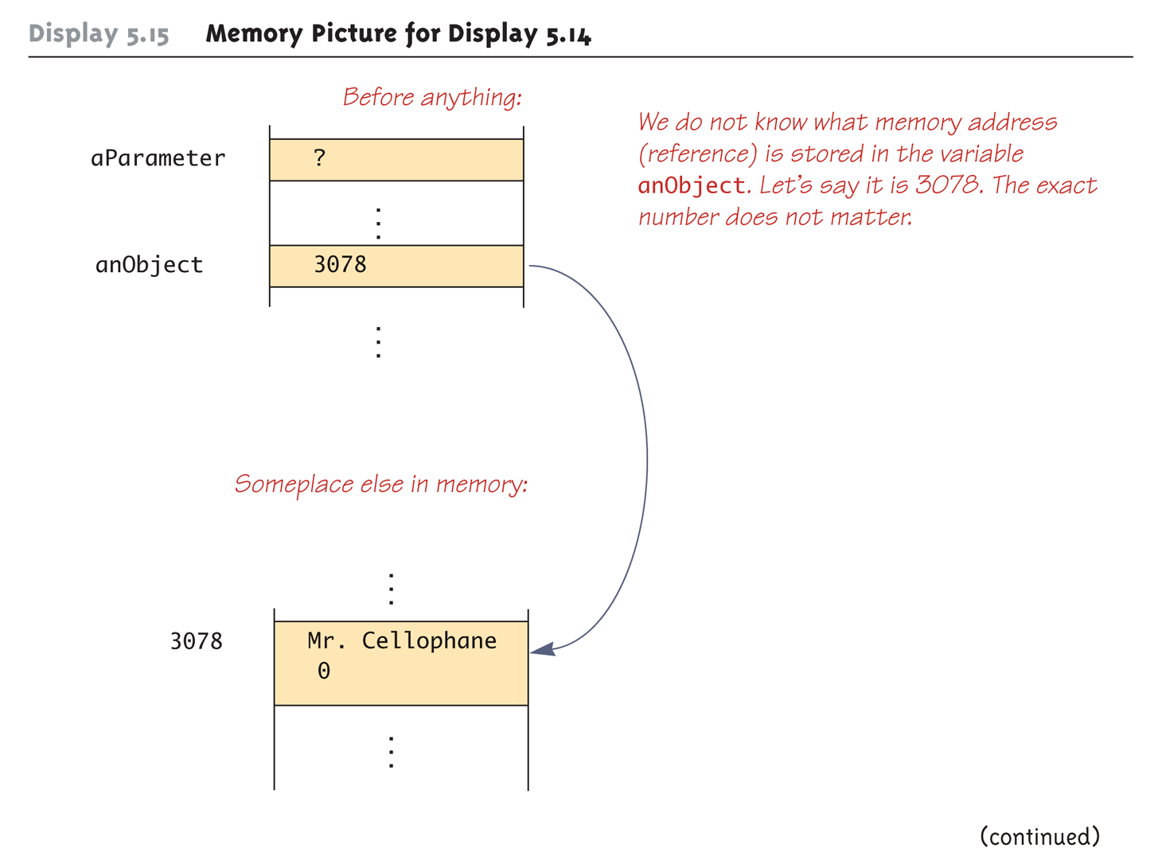
Memory Picture for Display 5.14 (Part 1 of 3)

Slide 44
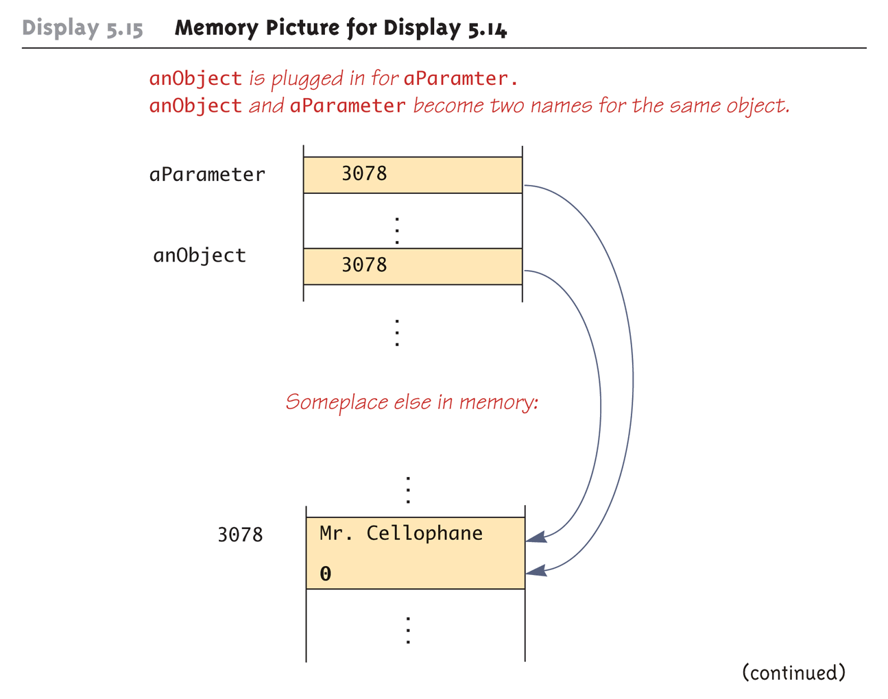
Memory Picture for Display 5.14 (Part 2 of 3)

Slide 45
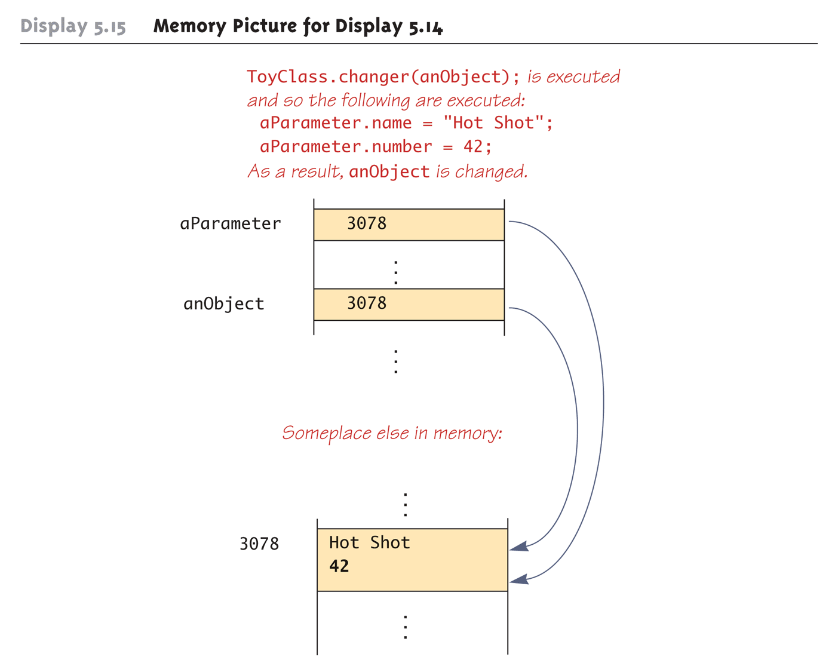
Memory Picture for Display 5.14 (Part 3 of 3)

Slide 46
Differences Between Primitive and Class-Type Parameters
A method cannot change the value of a variable of a primitive type that is an argument to the method
In contrast, a method can change the values of the instance variables of a class type that is an argument to the method

Slide 47
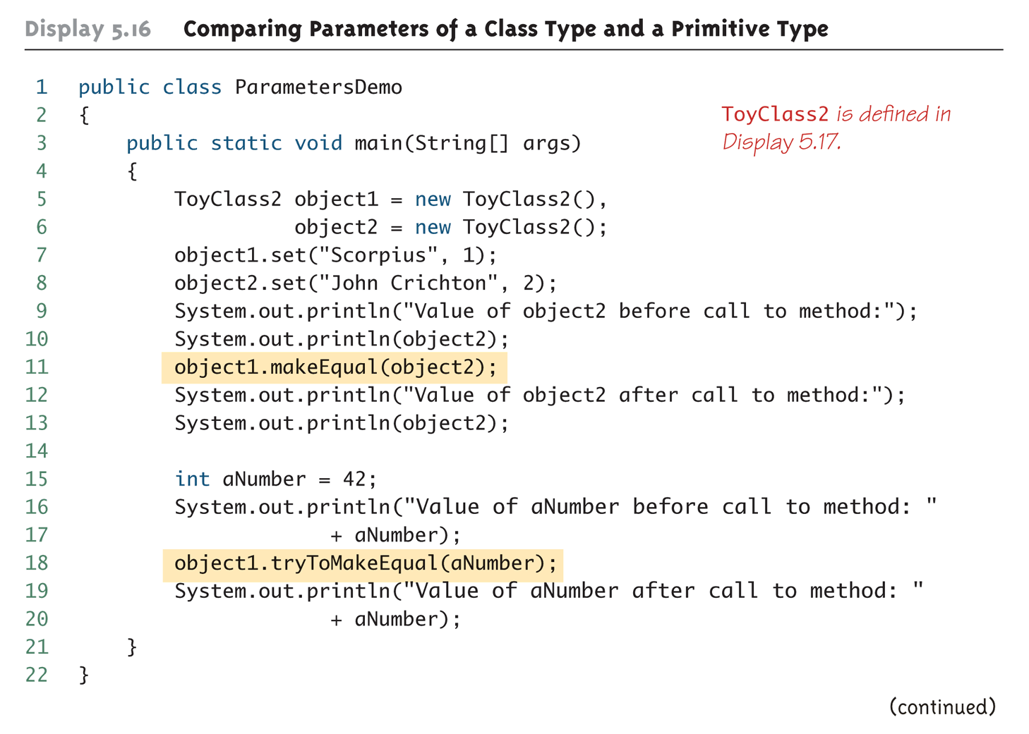
Comparing Parameters of a Class Type and a Primitive Type (Part 1 of 2)

Slide 48
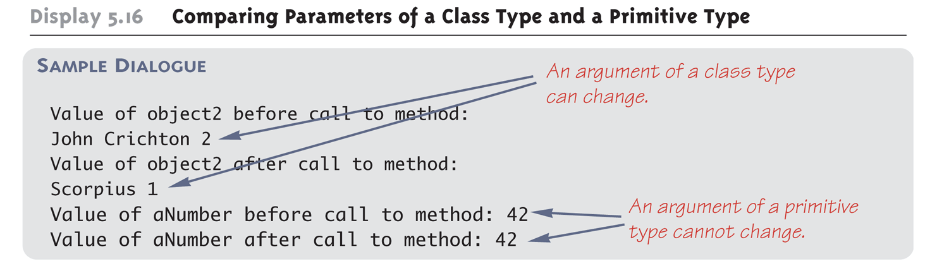
Comparing Parameters of a Class Type and a Primitive Type (Part 2 of 2)

Slide 49
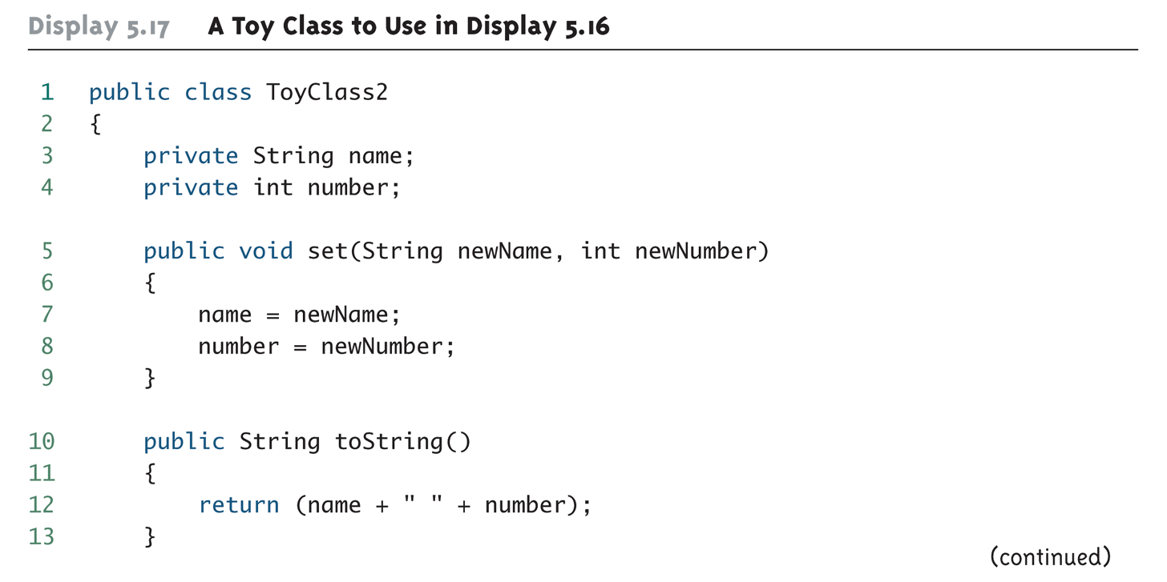
A Toy Class to Use in Display 5.16 (Part 1 of 2)

Slide 50
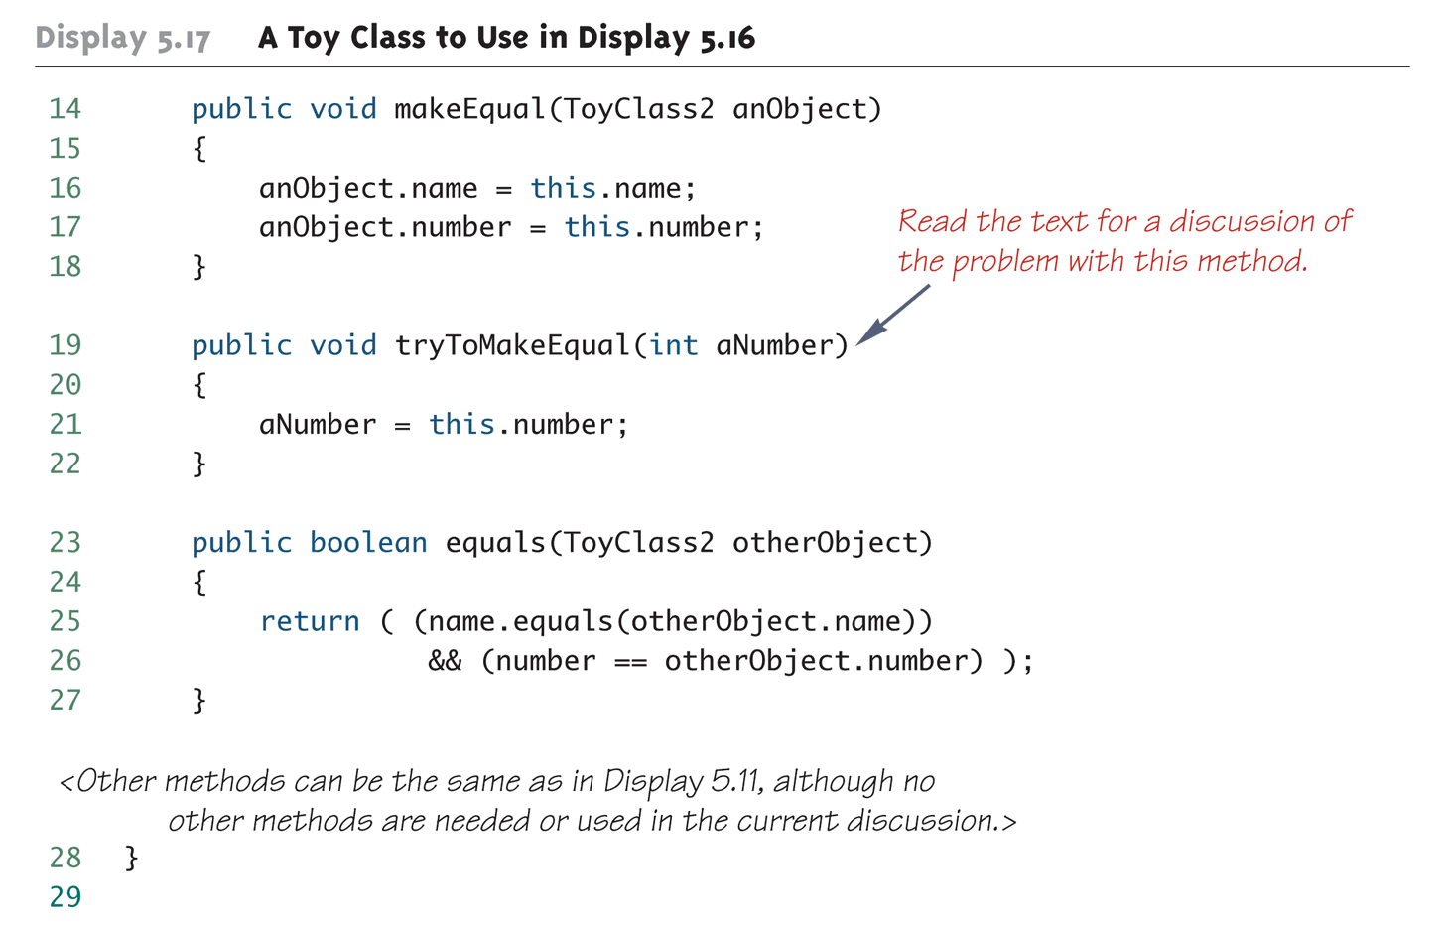
A Toy Class to Use in Display 5.16 (Part 2 of 2)

Slide 51
Pitfall: Use of = and == with Variables of a Class Type
Used with variables of a class type, the assignment operator (=) produces two variables that name the same object
This is very different from how it behaves with primitive type variables
The test for equality (==) also behaves differently for class type variables
The == operator only checks that two class type variables have the same memory address
Unlike the equals method, it does not check that their instance variables have the same values
Two objects in two different locations whose instance variables have exactly the same values would still test as being "not equal"

Slide 52
The Constant null
null is a special constant that may be assigned to a variable of any class type
YourClass yourObject = null;
It is used to indicate that the variable has no "real value"
It is often used in constructors to initialize class type instance variables when there is no obvious object to use
null is not an object: It is, rather, a kind of "placeholder" for a reference that does not name any memory location
Because it is like a memory address, use == or != (instead of equals) to test if a class variable contains null
if (yourObject == null) . . .

Slide 53
Pitfall: Null Pointer Exception
Even though a class variable can be initialized to null, this does not mean that null is an object
null is only a placeholder for an object
A method cannot be invoked using a variable that is initialized to null
The calling object that must invoke a method does not exist
Any attempt to do this will result in a "Null Pointer Exception" error message
For example, if the class variable has not been initialized at all (and is not assigned to null), the results will be the same

Slide 54
The new Operator and Anonymous Objects
The new operator invokes a constructor which initializes an object, and returns a reference to the location in memory of the object created
This reference can be assigned to a variable of the object's class type
Sometimes the object created is used as an argument to a method, and never used again
In this case, the object need not be assigned to a variable, i.e., given a name
An object whose reference is not assigned to a variable is called an anonymous object

Slide 55
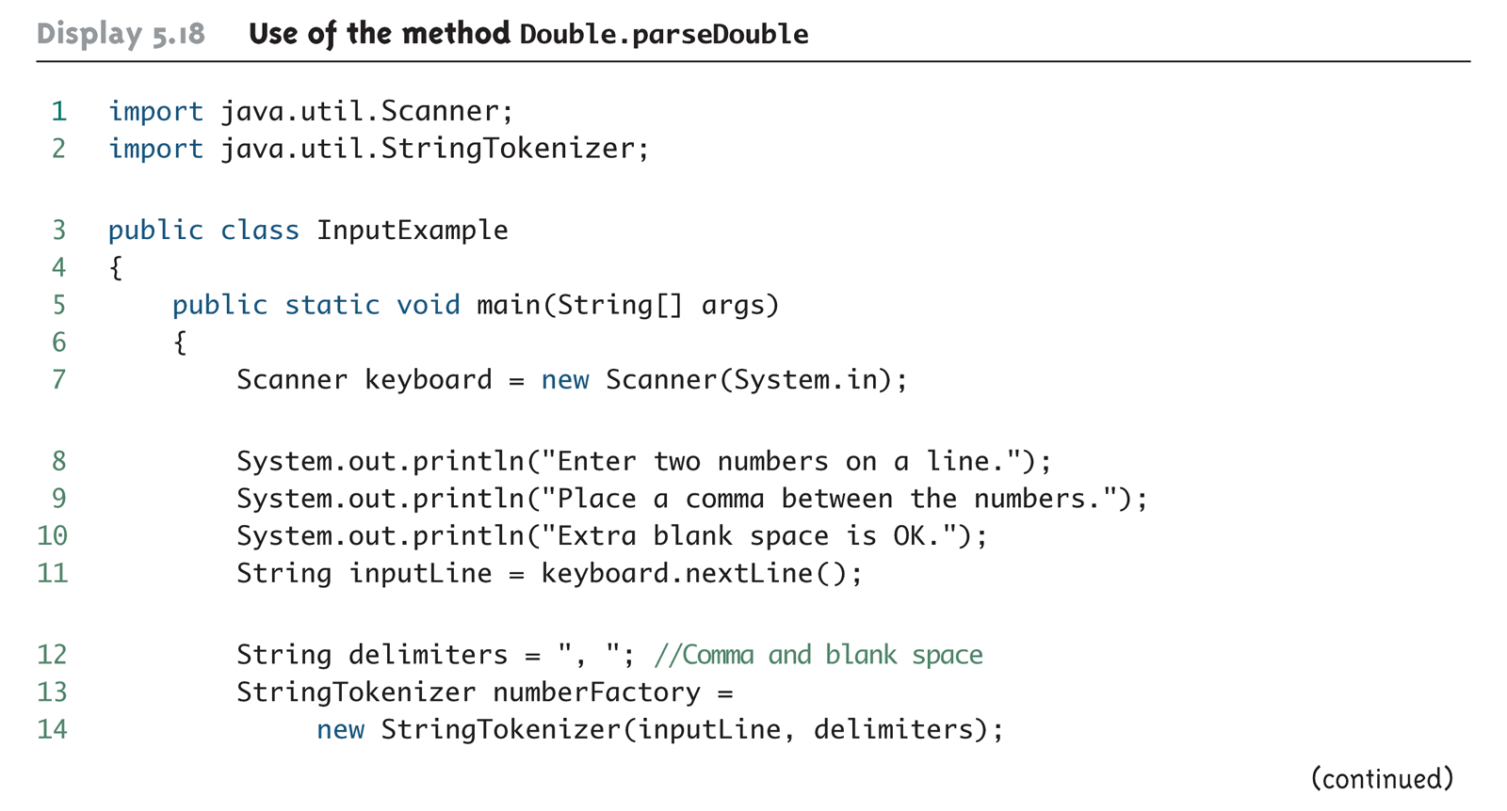
Another Approach to Keyboard Input Using Double.parseDouble (Part 1 of 3)

Slide 56
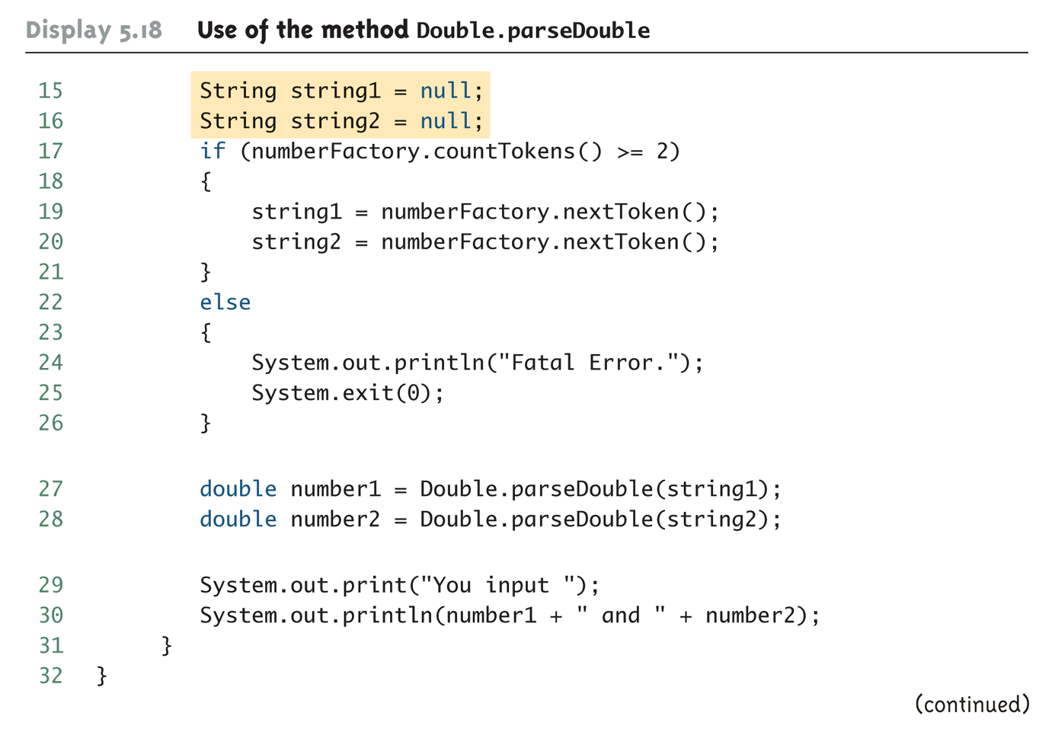
Another Approach to Keyboard Input Using Double.parseDouble (Part 2 of 3)

Slide 57
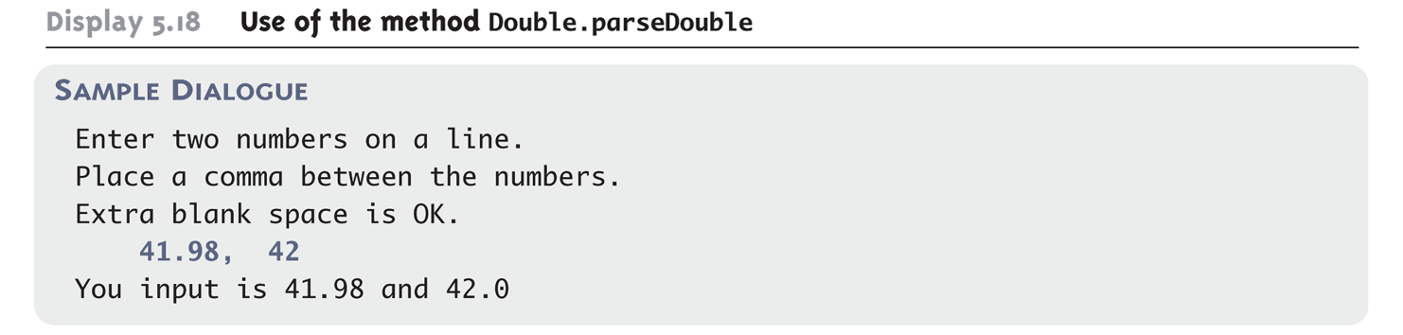
Another Approach to Keyboard Input Using Double.parseDouble (Part 3 of 3)

Slide 58
Using and Misusing References
When writing a program, it is very important to insure that private instance variables remain truly private
For a primitive type instance variable, just adding the private modifier to its declaration should insure that there will be no privacy leaks
For a class type instance variable, however, adding the private modifier alone is not sufficient

Slide 59
Designing A Person Class: Instance Variables
A simple Person class could contain instance variables representing a person's name, the date on which they were born, and the date on which they died
These instance variables would all be class types: name of type String, and two dates of type Date
As a first line of defense for privacy, each of the instance variables would be declared private
public class Person
{
private String name;
private Date born;
private Date died; //null is still alive
. . .

Slide 60
Designing a Person Class: Constructor
In order to exist, a person must have (at least) a name and a birth date
Therefore, it would make no sense to have a no-argument Person class constructor
A person who is still alive does not yet have a date of death
Therefore, the Person class constructor will need to be able to deal with a null value for date of death
A person who has died must have had a birth date that preceded his or her date of death
Therefore, when both dates are provided, they will need to be checked for consistency

Slide 61
A Person Class Constructor
public Person(String initialName, Date birthDate,
Date deathDate)
{
if (consistent(birthDate, deathDate))
{ name = initialName;
born = new Date(birthDate);
if (deathDate == null)
died = null;
else
died = new Date(deathDate);
}
else
{ System.out.println("Inconsistent dates.");
System.exit(0);
}
}

Slide 62
Designing a Person Class: the Class Invariant
A statement that is always true for every object of the class is called a class invariant
A class invariant can help to define a class in a consistent and organized way
For the Person class, the following should always be true:
An object of the class Person has a date of birth (which is not null), and if the object has a date of death, then the date of death is equal to or later than the date of birth
Checking the Person class confirms that this is true of every object created by a constructor, and all the other methods (e.g., the private method consistent) preserve the truth of this statement

Slide 63
Designing a Person Class: the Class Invariant
/** Class invariant: A Person always has a date of birth,
and if the Person has a date of death, then the date of
death is equal to or later than the date of birth.
To be consistent, birthDate must not be null. If there
is no date of death (deathDate == null), that is
consistent with any birthDate. Otherwise, the birthDate
must come before or be equal to the deathDate.
*/
private static boolean consistent(Date birthDate, Date
deathDate)
{
if (birthDate == null) return false;
else if (deathDate == null) return true;
else return (birthDate.precedes(deathDate ||
birthDate.equals(deathDate));
}

Slide 64
Designing a Person Class: the equals and datesMatch Methods
The definition of equals for the class Person includes an invocation of equals for the class String, and an invocation of the method equals for the class Date
Java determines which equals method is being invoked from the type of its calling object
Also note that the died instance variables are compared using the datesMatch method instead of the equals method, since their values may be null

Slide 65
Designing a Person Class: the equals Method
public boolean equals(Person otherPerson)
{
if (otherPerson == null)
return false;
else
return (name.equals(otherPerson.name) &&
born.equals(otherPerson.born) &&
datesMatch(died, otherPerson.died));
}

Slide 66
Designing a Person Class: the matchDate Method
/** To match date1 and date2 must either be the
same date or both be null.
*/
private static boolean datesMatch(Date date1,
Date date2)
{
if (date1 == null)
return (date2 == null);
else if (date2 == null) //&& date1 != null
return false;
else // both dates are not null.
return(date1.equals(date2));
}

Slide 67
Designing a Person Class: the toString Method
Like the equals method, note that the Person class toString method includes invocations of the Date class toString method
public String toString( )
{
String diedString;
if (died == null)
diedString = ""; //Empty string
else
diedString = died.toString( );
return (name + ", " + born + "-" + diedString);
}

Slide 68
Copy Constructors
A copy constructor is a constructor with a single argument of the same type as the class
The copy constructor should create an object that is a separate, independent object, but with the instance variables set so that it is an exact copy of the argument object
Note how, in the Date copy constructor, the values of all of the primitive type private instance variables are merely copied

Slide 69
Copy Constructor for a Class with Primitive Type Instance Variables
public Date(Date aDate)
{
if (aDate == null) //Not a real date.
{
System.out.println("Fatal Error.");
System.exit(0);
}
month = aDate.month;
day = aDate.day;
year = aDate.year;
}

Slide 70
Copy Constructor for a Class with Class Type Instance Variables
Unlike the Date class, the Person class contains three class type instance variables
If the born and died class type instance variables for the new Person object were merely copied, then they would simply rename the born and died variables from the original Person object
born = original.born //dangerous
died = original.died //dangerous
This would not create an independent copy of the original object

Slide 71
Copy Constructor for a Class with Class Type Instance Variables
The actual copy constructor for the Person class is a "safe" version that creates completely new and independent copies of born and died, and therefore, a completely new and independent copy of the original Person object
For example:
born = new Date(original.born);
Note that in order to define a correct copy constructor for a class that has class type instance variables, copy constructors must already be defined for the instance variables' classes

Slide 72
Copy Constructor for a Class with Class Type Instance Variables
public Person(Person original)
{
if (original == null)
{
System.out.println("Fatal error.");
System.exit(0);
}
name = original.name;
born = new Date(original.born);
if (original.died == null)
died = null;
else
died = new Date(original.died);
}

Slide 73
Pitfall: Privacy Leaks
The previously illustrated examples from the Person class show how an incorrect definition of a constructor can result in a privacy leak
A similar problem can occur with incorrectly defined mutator or accessor methods
For example:
public Date getBirthDate()
{
return born; //dangerous
}
Instead of:
public Date getBirthDate()
{
return new Date(born); //correct
}

Slide 74
Mutable and Immutable Classes
The accessor method getName from the Person class appears to contradict the rules for avoiding privacy leaks:
public String getName()
{
return name; //Isn't this dangerous?
}
Although it appears the same as some of the previous examples, it is not: The class String contains no mutator methods that can change any of the data in a String object

Slide 75
Mutable and Immutable Classes
A class that contains no methods (other than constructors) that change any of the data in an object of the class is called an immutable class
Objects of such a class are called immutable objects
It is perfectly safe to return a reference to an immutable object because the object cannot be changed in any way
The String class is an immutable class

Slide 76
Mutable and Immutable Classes
A class that contains public mutator methods or other public methods that can change the data in its objects is called a mutable class, and its objects are called mutable objects
Never write a method that returns a mutable object
Instead, use a copy constructor to return a reference to a completely independent copy of the mutable object

Slide 77
Deep Copy Versus Shallow Copy
A deep copy of an object is a copy that, with one exception, has no references in common with the original
Exception: References to immutable objects are allowed to be shared
Any copy that is not a deep copy is called a shallow copy
This type of copy can cause dangerous privacy leaks in a program

Slide 78
Packages and Import Statements
Java uses packages to form libraries of classes
A package is a group of classes that have been placed in a directory or folder, and that can be used in any program that includes an import statement that names the package
The import statement must be located at the beginning of the program file: Only blank lines, comments, and package statements may precede it
The program can be in a different directory from the package

Slide 79
Import Statements
We have already used import statements to include some predefined packages in Java, such as Scanner from the java.util package
import java.util.Scanner;
It is possible to make all the classes in a package available instead of just one class:
import java.util.*;
Note that there is no additional overhead for importing the entire package

Slide 80
The package Statement
To make a package, group all the classes together into a single directory (folder), and add the following package statement to the beginning of each class file:
package package_name;
Only the .class files must be in the directory or folder, the .java files are optional
Only blank lines and comments may precede the package statement
If there are both import and package statements, the package statement must precede any import statements

Slide 81
The Package java.lang
The package java.lang contains the classes that are fundamental to Java programming
It is imported automatically, so no import statement is needed
Classes made available by java.lang include Math, String, and the wrapper classes

Slide 82
Package Names and Directories
A package name is the path name for the directory or subdirectories that contain the package classes
Java needs two things to find the directory for a package: the name of the package and the value of the CLASSPATH variable
The CLASSPATH environment variable is similar to the PATH variable, and is set in the same way for a given operating system
The CLASSPATH variable is set equal to the list of directories (including the current directory, ".") in which Java will look for packages on a particular computer
Java searches this list of directories in order, and uses the first directory on the list in which the package is found

Slide 83
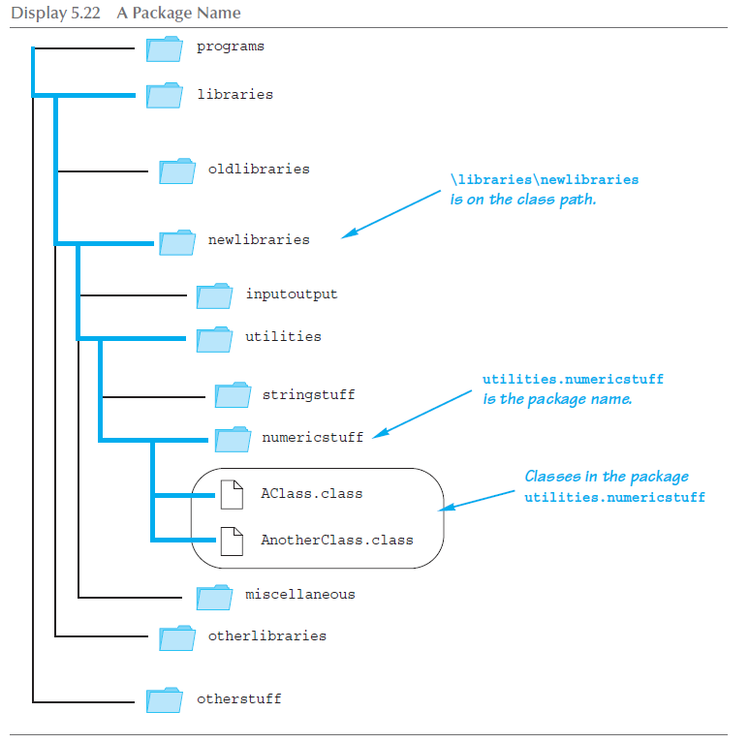
A Package Name

Slide 84
Pitfall: Subdirectories Are Not Automatically Imported
When a package is stored in a subdirectory of the directory containing another package, importing the enclosing package does not import the subdirectory package
The import statement:
import utilities.numericstuff.*;
imports the utilities.numericstuff package only
The import statements:
import utilities.numericstuff.*;
import utilities.numericstuff.statistical.*;
import both the utilities.numericstuff and
utilities.numericstuff.statistical packages

Slide 85
The Default Package
All the classes in the current directory belong to an unnamed package called the default package
As long as the current directory (.) is part of the CLASSPATH variable, all the classes in the default package are automatically available to a program

Slide 86
Pitfall: Not Including the Current Directory in Your Class Path
If the CLASSPATH variable is set, the current directory must be included as one of the alternatives
Otherwise, Java may not even be able to find the .class files for the program itself
If the CLASSPATH variable is not set, then all the class files for a program must be put in the current directory

Slide 87
Specifying a Class Path When You Compile
The class path can be manually specified when a class is compiled
Just add –classpath followed by the desired class path
This will compile the class, overriding any previous CLASSPATH setting
You should use the –classpath option again when the class is run

Slide 88
Name Clashes
In addition to keeping class libraries organized, packages provide a way to deal with name clashes: a situation in which two classes have the same name
Different programmers writing different packages may use the same name for one or more of their classes
This ambiguity can be resolved by using the fully qualified name (i.e., precede the class name by its package name) to distinguish between each class
package_name.ClassName
If the fully qualified name is used, it is no longer necessary to import the class (because it includes the package name already)

Slide 89
Introduction to javadoc
Unlike a language such as C++, Java places both the interface and the implementation of a class in the same file
However, Java has a program called javadoc that automatically extracts the interface from a class definition and produces documentation
This information is presented in HTML format, and can be viewed with a Web browser
If a class is correctly commented, a programmer need only refer to this API (Application Programming Interface) documentation in order to use the class
javadoc can obtain documentation for anything from a single class to an entire package

Slide 90
Commenting Classes for javadoc
The javadoc program extracts class headings, the headings for some comments, and headings for all public methods, instance variables, and static variables
In the normal default mode, no method bodies or private items are extracted
To extract a comment, the following must be true:
The comment must immediately precede a public class or method definition, or some other public item
The comment must be a block comment, and the opening /* must contain an extra * ( /** . . . */ )
Note: Extra options would have to be set in order to extract line comments ( // ) and private items

Slide 91
Commenting Classes for javadoc
In addition to any general information, the comment preceding a public method definition should include descriptions of parameters, any value returned, and any exceptions that might be thrown
This type of information is preceded by the @ symbol and is called an @ tag
@ tags come after any general comment, and each one is on a line by itself
/**
General Comments about the method . . .
@param aParameter Description of aParameter
@return What is returned
. . .
*/

Slide 92
@ Tags
@ tags should be placed in the order found below
If there are multiple parameters, each should have its own @param on a separate line, and each should be listed according to its left-to-right order on the parameter list
If there are multiple authors, each should have its own @author on a separate line
@param Parameter_Name Parameter_Description
@return Description_Of_Value_Returned
@throws Exception_Type Explanation
@deprecated
@see Package_Name.Class_Name
@author Author
@version Version_Information

Slide 93
Running javadoc
To run javadoc on a package, give the following command:
javadoc –d Documentation_Directory Package_Name
The HTML documents produced will be placed in the Documentation_Directory
If the –d and Documentation_Directory are omitted, javadoc will create suitable directories for the documentation
To run javadoc on a single class, give the following command from the directory containing the class file: javadoc ClassName.java
To run javadoc on all the classes in a directory, give the following command instead: javadoc *.java

Slide 94
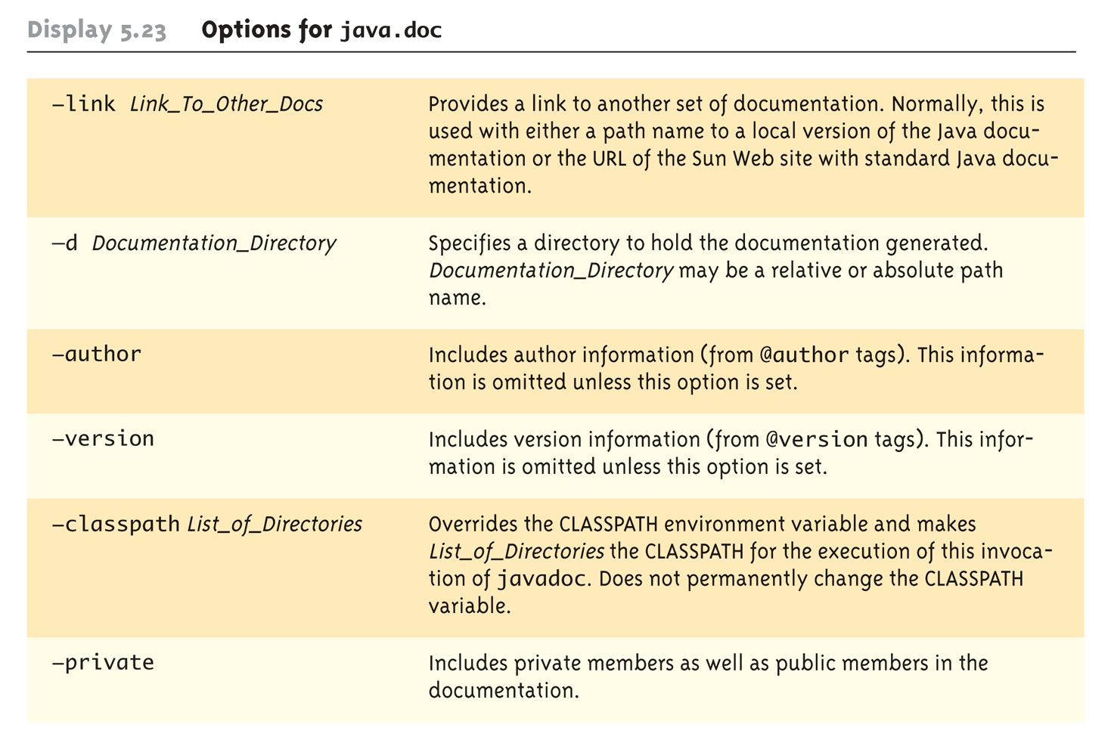
Options for javadoc

